Slide 1
Matan Becker
Data Analytics Intern / A Day in the Life of an IA Intern / Friday 04 August 2017

Slide 2





About me:
Born and raised in Atlanta, Georgia
BBA in Finance from The University of Georgia
Senior Operations Analyst for 2.5 years in the Healthcare Supply Chain industry
Currently pursuing a Master’s in Analytics from Georgia State

Slide 3
My Team
Department: Infrastructure Architecture
Manager:
Chuck Warne – Director, Architecture
Team members:
Su Bae: Data Modeler
Harvinder Singh: Senior Architect II
Brad Harris: Senior Architect II
Hakjoong Kim- Data Analytics Analyst

Slide 4
Data Access Methods from Hadoop
My Project:
Evaluate various data access methods to query data stored in the Hadoop platform using distributed OLAP and in-memory technologies and provide recommendations
Business Context/Problem:
Travelport has a massive amount of transaction log data that is difficult to access and analyze
Data currently needs to be extracted out of Hadoop into a relational database to analyze; very inefficient and time-consuming
Data has not been used to drive business insight
Objective:
Analyze Hadoop data inside BI Applications with sub-second query times
Technologies Evaluated: 1) Apache Kylin 2) Spark SQL

Slide 5
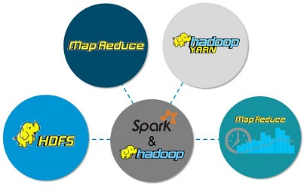

Data Access Methods from Hadoop
Apache Kylin - extremely fast distributed OLAP engine that offers SQL on Hadoop
Uses “cubes” which are multi-dimensional datasets that are pre-aggregated “sub-segments” of a database
Why should Travelport use this?
Reduces query latency on Hadoop
Increases ability to analyze log data and drive business insights
Spark/Spark SQL – Runs on top of Hadoop and processes data “in-memory” instead of on disk
makes repeated access to the same data much faster
Why should Travelport use this?
Faster than Hadoop MapReduce
Lots of optimization options available
Notes:
*Focus on the why Travelport

Slide 6
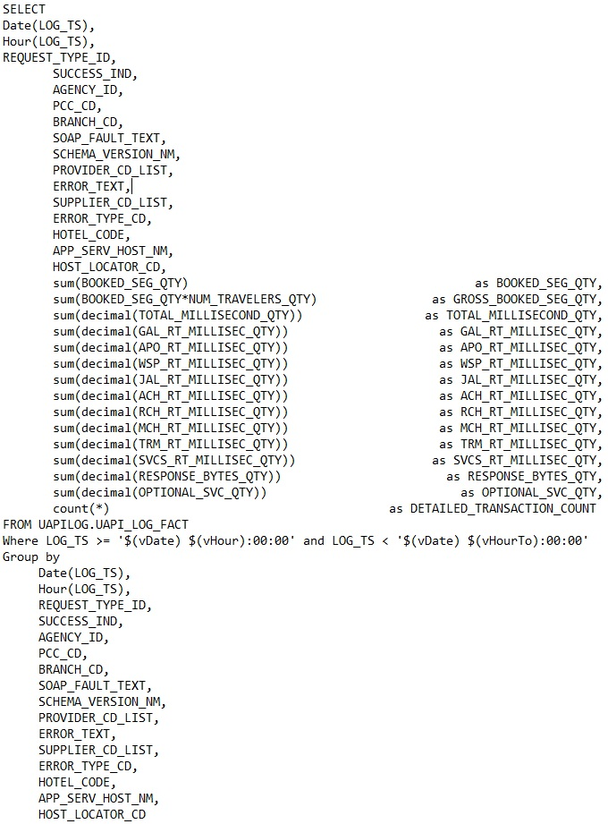
Data Access Methods from Hadoop
What I did for Kylin:
Modeled and built Kylin OLAP cubes using data from Hadoop and connected to SQL client/BI Applications
Ran aggregated queries to measure performance
What I did for Spark SQL:
Wrote Pyspark script and ran aggregated Spark SQL queries in Hadoop; measured performance
Created process document for creating OLAP cube and querying in SparkSQL for interns/new hires to come
Notes:
* Compared Kylin and Spark SQL “apples to apples”

Slide 7
Results
Kylin OLAP cubes query data much faster than HIVE or SparkSQL; see chart below
Kylin is very compatible with many BI Applications
DATA
Stats | RAW_ULOGS Table
Number of rows | 615,797,147
Raw Size | 1.65 TB
Number of Partitions | 10
Number of Files | 19

Slide 8
Results
Comparison Matrix:
Query | Apache Kylin | Spark SQL | Hive
Hourly Aggregates | .428 sec | 62 sec | 147.3 sec
Daily Aggregates | .854 sec | 80 sec | 137.2 sec
Air Cancellation Rate | N/A | 19 sec | 80.5 sec
Best Practices | Access Method
Memory Storage | Spark
Cube Build | Spark
Query Performance | Kylin Cube
Notes:
*Cubes were built for specific Cognos queries

Slide 9
Recommendations
Build cubes for queries that require a lot of computation/aggregation
When you have a known set of data that can be summarized or aggregated
For ad-hoc queries, another tool would be required
Use Hive for simpler queries as it is easier to use than SparkSQL and can still run queries on big data relatively fast
Use Spark-SQL:
When better query performance than hive is required
Tradeoff between complexity and faster query times

Slide 10
Takeaways
Main takeaway: you can learn anything from google
Additional things I learned this summer:
How to navigate and build applications in Linux
New Big Data Technologies (Hadoop, Spark, YARN, HIVE)
Data warehousing fundamentals, OLAP cubes & cube design methodologies
Working towards HCA (Hortonworks Certified Associate) Certification with other Big Data interns

Slide 11
Questions?

